Slide 1


Introduction to Materials Property Prediction
Dane Morgan, Ryan Jacobs (University of Wisconsin - Madison, Wisconsin, USA)
Ben Afflerbach (Fort Lewis College, Colorado, USA)
Part of TMS Online Course: Artificial Intelligence and Machine Learning
Part of Module 3: Approaches to Materials Property Prediction with Machine Learning
October 27-29, 2025

Slide 2
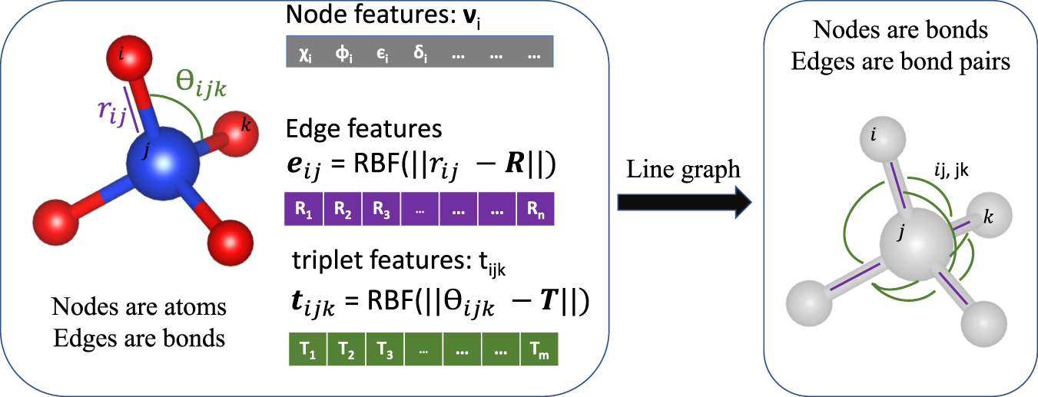
Using Atomic Structure as Features
Mole fractions or Elemental Property features are powerful but have no structural information (e.g., will predict band gap of all polymorphs as the same).
If you have atomic structures (very common with simulated data) it is generally better to featurize with all that information.
A very powerful approach to this is a graph neural network.
Example of the Atomistic Line Graph Neural Network (ALIGNN)
Builds features from atomic structure and elemental properties.
Has learnable updates to features followed by a simple regression on final pooled vector.
Choudhury and DeCost, npj Comp. Mat. ‘21

Slide 3
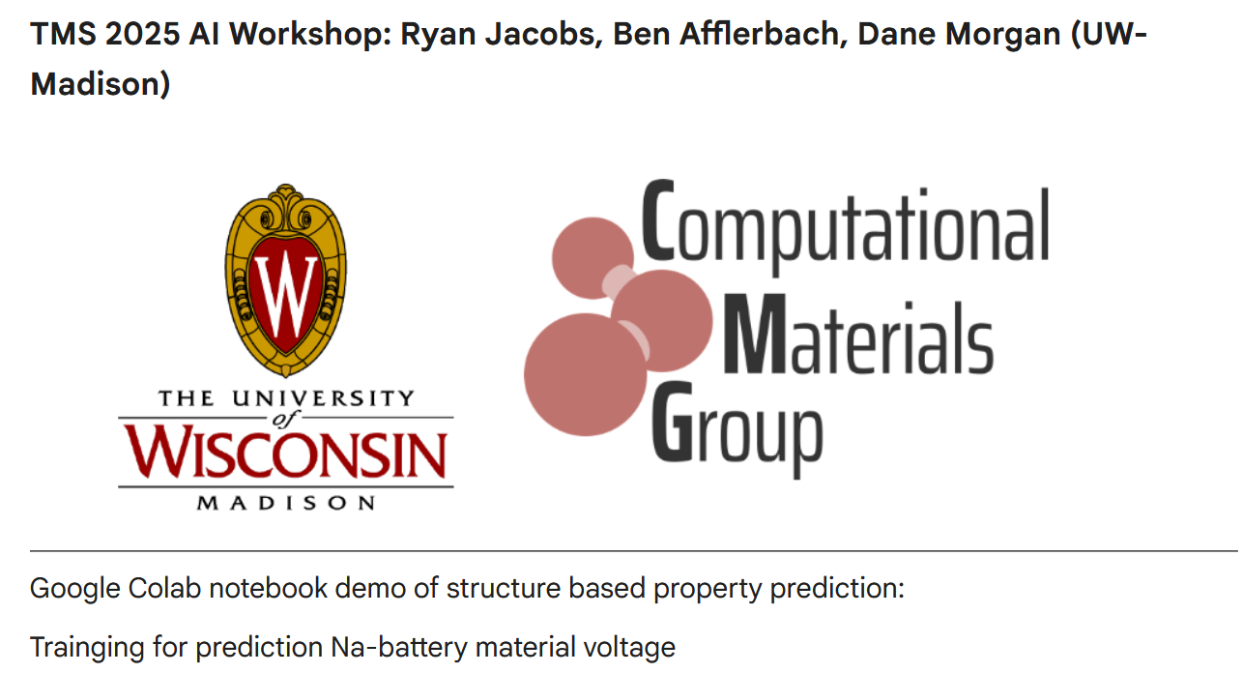
ALIGNN Tutorial Notebook
Our ALIGNN tutorial will equip you with the tools needed to train a structure-based property predictor on your own data and for your own property of interest
We will now move on to our lab activity, where we will:
Train a Voltage prediction graph neural network using UMLIP-calculated average voltages of prospective Na-cathode materials including only their structures as features.
Use our trained property predictor to perform a follow-up investigation of a candidate material, modifying various aspects of its structure

